Slide 1

#GetReal
Augmented Reality
Cedric Kim, Daniel Daugherty, Kevin Guo, Kevin Zhang

Slide 2
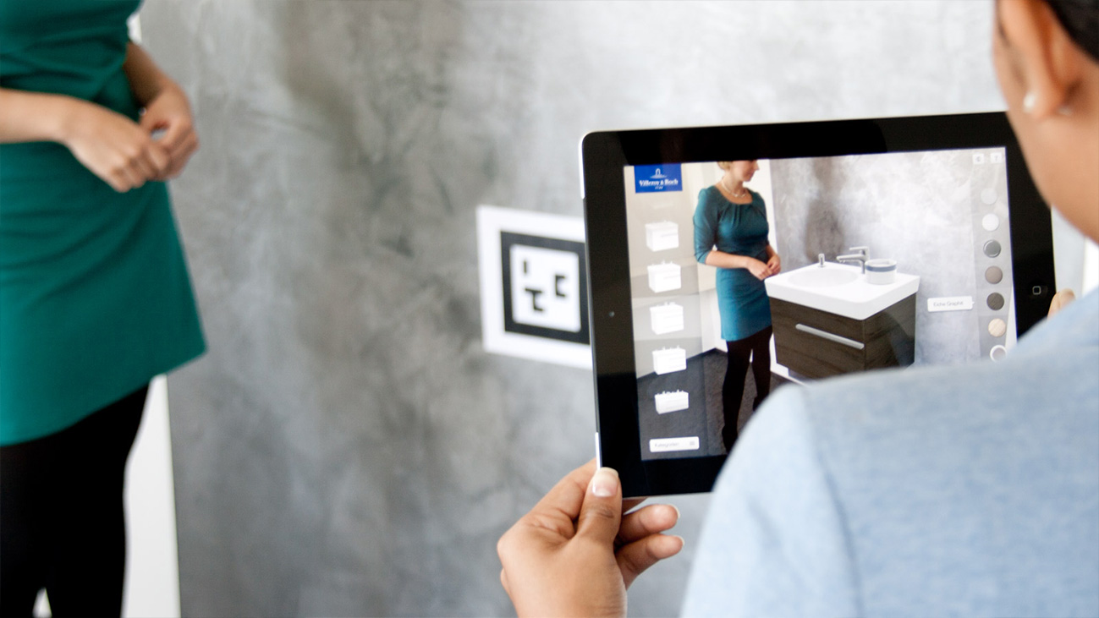
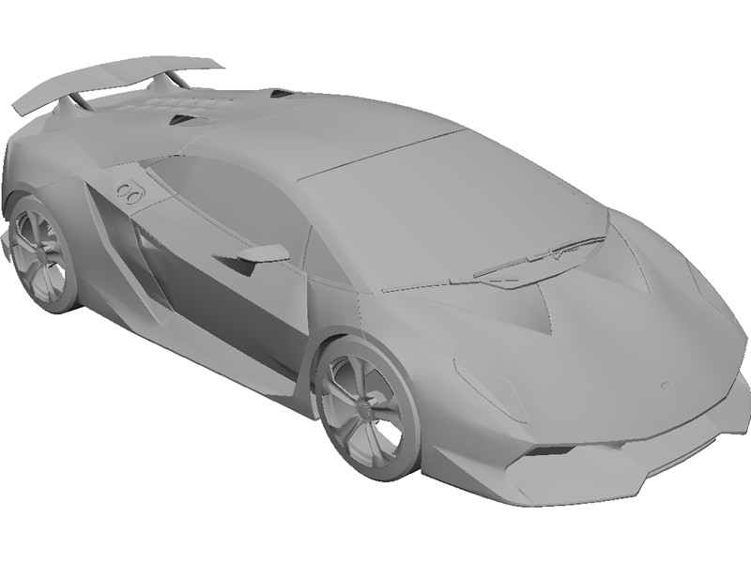
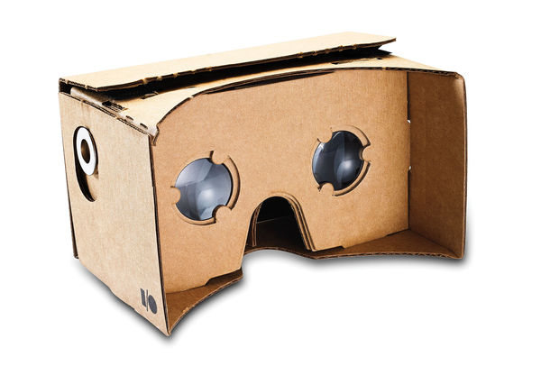

What is #GetReal?

Slide 3
Code Architecture
Augmented Reality Controller
Video Feed Capture
Marker Tracking
Visualization Controller

Slide 5
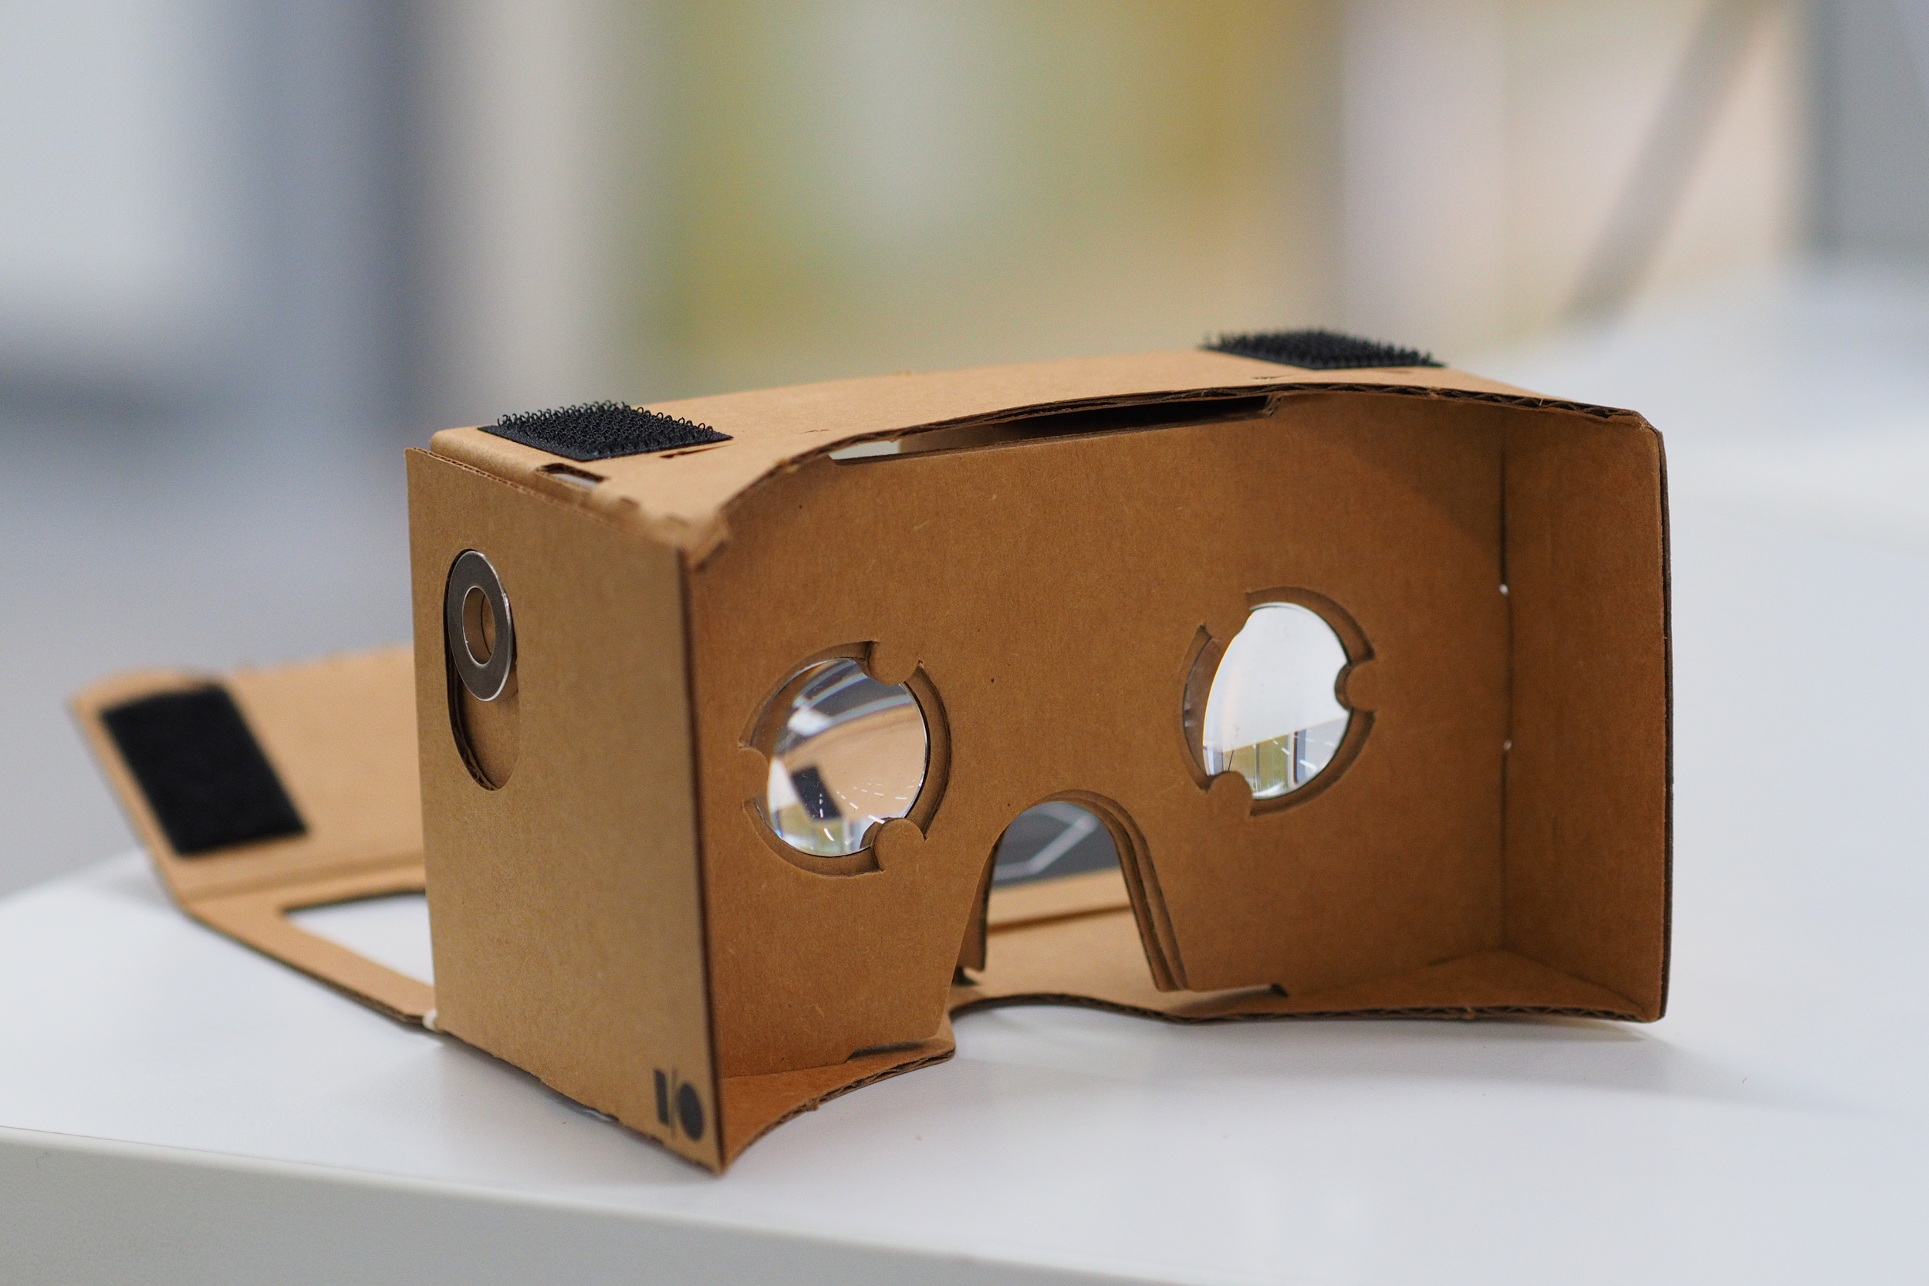
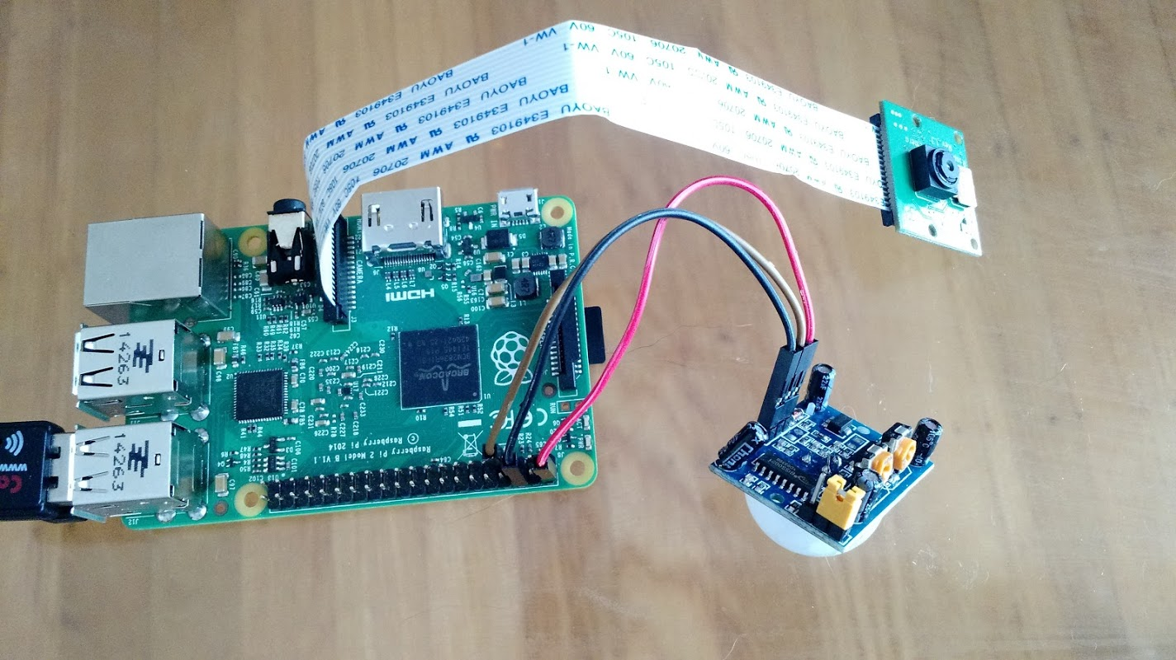
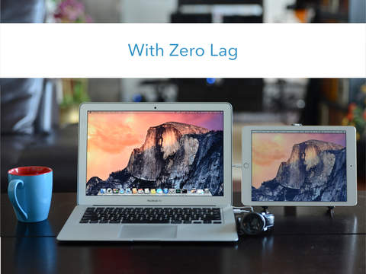


Devices and Libraries
Vision Tracking - OpenCV
Graphics - OpenGL and GLUT
CAD models - STL
VR - Google Cardboard, Neato camera + Raspberry Pi, and Duet Display

Slide 6
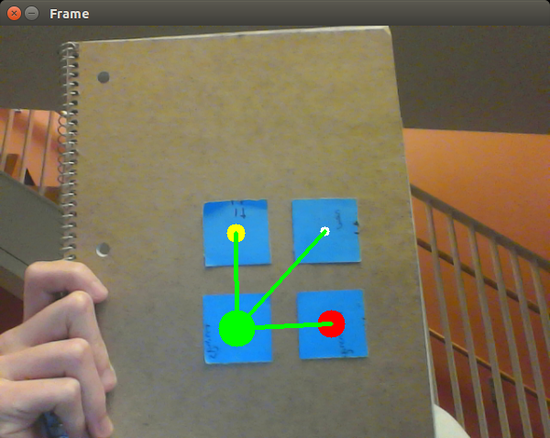
Step 1: Tracking the Marker
Orientation
Mask
Moments
Quadrant Math
https://www.youtube.com/watch?v=6U1U8XrYHos

Slide 7
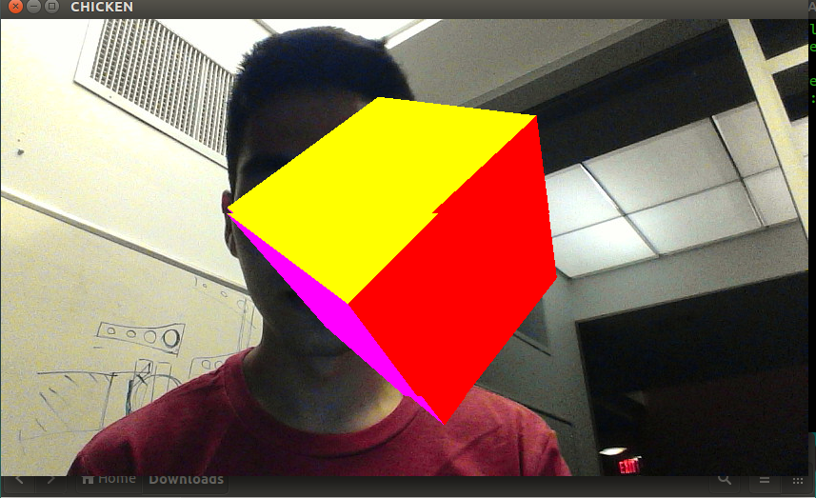
Step 2: Rendering the Graphics
Convert OpenCV numpy array to OpenGL format
Overlaying 3D objects on 2D projection.
Manipulate objects within 3D space.
https://www.youtube.com/watch?v=UUB_L_ZMa2s

Slide 8
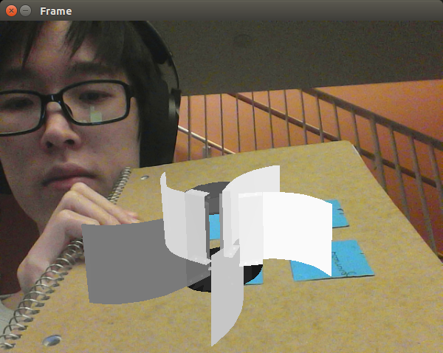
Step 3: Combining the Two Together (kind of)
Calibrate Camera
Import STL
Format Mesh (list of 3 points)
3D - 2D point correspondence
Project Points
https://www.youtube.com/watch?v=c79XzxHyZ18&feature=youtu.be

Slide 9
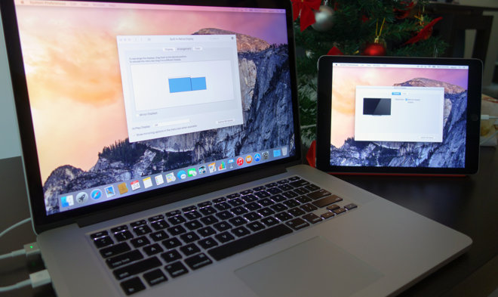
Next Steps
Iron out bugs
Render STL in OpenGL
Integrate with Google Cardboard and the Neato Camera
Establish route to Duet Display

Slide 10
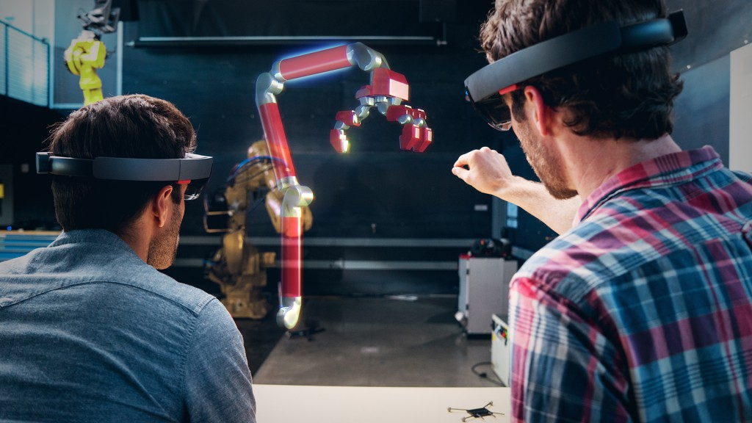
Stretch Goals

Slide 11
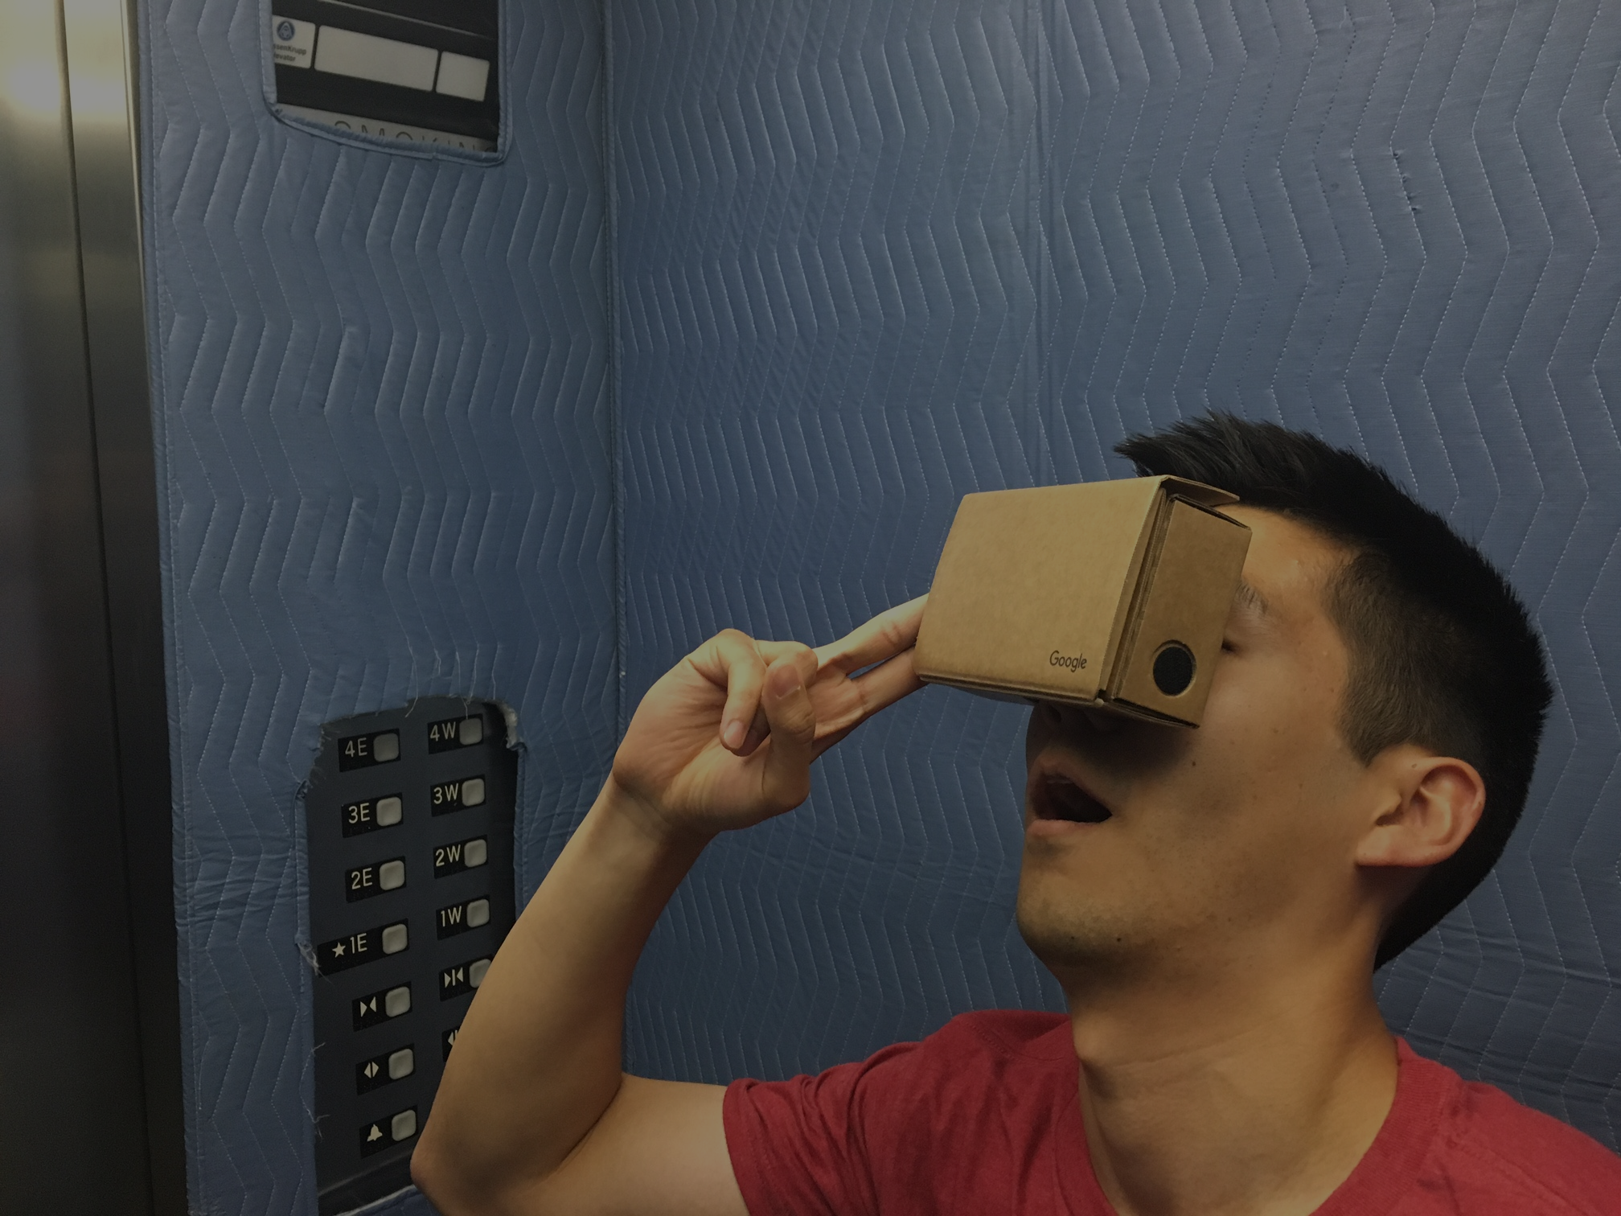
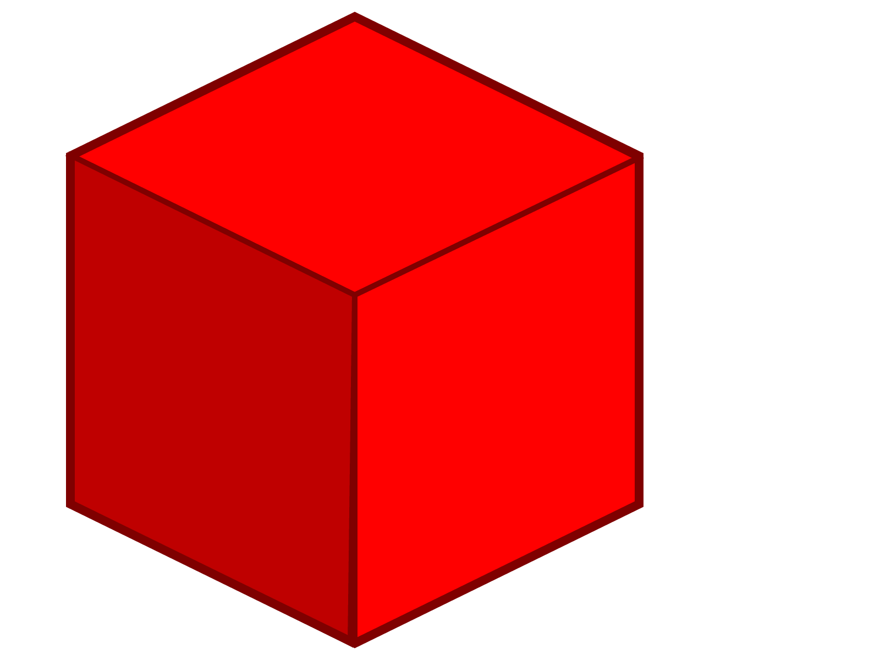
Thanks!

